Slide 1

Hackathon Preparation Workshop
Brought to you by CompSoc and ShefESH

Slide 2
Session Overview
Timetable
What is a hackathon? How to do a perfect pitch
Ideal workflow
Tools:
  Git
  Python + Supabase
  Flask
  React
    Tailwind
Devpost
Do and Don’ts
What to bring
Notes:
Timetable
Walkthrough
Description of events
What is a hackathon
Choose one focus
Focus on core idea + pitch rather than finished product
Only have 24 hours
Python
Python Top Tips
Supabase vs SQLite
Why use it
What benefits
Flask
Python backend
Does frontend
Very simple
React/NextJS
Bigger than flask
Easier for bigger projects
Javascript
Harder if no experience but outcome probably greater (?)
Tailwind
Easy inline styling
Common Practices
Dos and Don’ts
Do
Have fun
Don’t
Spend ages worrying about tiny feature
Spend too much time researching
What to bring
Essentials v Comfort

Slide 3
Timetable

Slide 4
Saturday
09:00 | Doors Open
10:00 | Team Building
10:30 - 12:00 | Opening Ceremony
12:00 | Hacking Begins!
13:00 | Lunch
14:00 - 14:45 | Reply: Agentic AI Workshop
15:00 - 15:30 | Introduction to Gafana
16:00 | ShefESH: Capture The Flag
17:00 - 18:30 | Carnival Games
19:00 | Dinner
20:00 - 21:00 | TechVision: Leetcode challenge
21:00 - 22:00 | GameDev Soc: Gamification Mini Competition
23:00 | Group Minigame: Werewolf

Slide 5
Sunday
09:00 | Morning Snacks
10:00 | Morning Walk
12:00 | Hacking Closes + Lunch
13:00 - 17:00 | Judging + Closing

Slide 6
What is a hackathon?

Slide 7
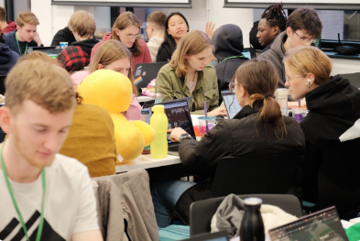
What is it?
An event where people come together to solve challenges through
  intense software development,
  rapid prototyping, and
  working collaboratively
Goal: To prototype a product
surrounding a theme, and
persuade the panel of judges with
your pitch
Notes:
Primary goal is to not have a finished product, but persuade the panel of judges. It is phrased that way because, you are pitch is very important
It tests your teamwork, creativity and communication skills

Slide 8
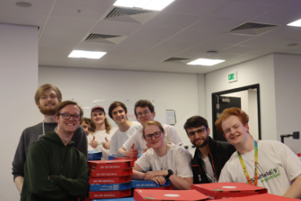
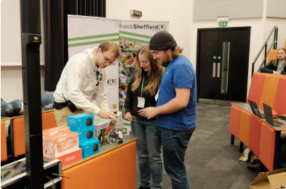
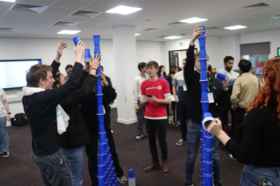
What is it?
HackSheff: 24 hour Hackathon
It will be quite competitive, some stay up all night working on this
There will be a list of themes,
  Pick one and aim to win in that

Slide 9
Pitch is as important as your product

Slide 10
How to Pitch?
🗣️
Before pitch, aim to get a MVP (Minimal Viable Product) instead of a perfect product
You will have roughly 3 minutes for your presentation
Notes:
Generally hackathon pitches are around 3min, unless stated otherwise, itll be same for sheffHack during the hackathon

Slide 11
How to Pitch?
Aim for:
  Short, captivating hook -> have a compelling narrative linked to the theme, keep it grounded, introduce problem
  Present your solution -> have a demo, show its uniqueness and strengths
  Explain its impact and talk about decisions you made in the prototyping phase
  Know what judges are looking for, tailor to it
  Aim for a strong finish, the start and end is what they will stick with them
Important: Make it unique and interesting, there will be min 50+ team presenting, try to stand out and be memorable

Slide 12
Saturday
09:00 | Doors Open
10:00 | Team Building
10:30 - 12:00 | Opening Ceremony
12:00 | Hacking Begins!
13:00 | Lunch
14:00 - 14:45 | Reply: Agentic AI Workshop
15:00 - 15:30 | Introduction to Gafana
16:00 | ShefESH: Capture The Flag
17:00 - 18:30 | Carnival Games
19:00 | Dinner
20:00 - 21:00 | TechVision: Leetcode challenge
21:00 - 22:00 | GameDev Soc: Gamification Mini Competition
23:00 | Group Minigame: Werewolf
Building
Brainstorm
Project setup
Prototyping

Slide 13
Ideal Workflow
Final Touches
09:00 | Morning Snacks
10:00 | Morning Walk
12:00 | Hacking Closes + Lunch
13:00 - 17:00 | Judging + Closing
Focus on presentation
Notes:
A very rough guideline, obvi some of u will want to do different scheduled activities, stay up late, have different priorities. So, here is a rough guideline:

Slide 14
Ideal Workflow
Brainstorming & Deciding Roles - roughly 1-1:30 hrs
  Define the problem, discuss ideas, scope & align team
Project Setup - 30 mins
  Setup repo, assign role, define MVP features (use issues for project management)
Building - 60%
  Core application logic, basic UI
Prototyping - 40 %
  Integrate components, basic testing
  Useable demo by the end of day 1
Refining for theme - 2 hours
Making presentation & Practice Pitch - 1- 1:30 hrs

Slide 15
Tools
Example Tech Stack

Slide 16
Example
Front-end: React (JavaScript)
Back-end: Flask (Python)
Data Storage + Auth: Supabase (PostgreSQL)
Version-Control: GitHub

Slide 17
Git and GitHub

Slide 18
What is Git?
Git is a popular version control system used for tracking code changes, who made them and code collaboration
Things you can do with git:
  Create a repository by initialising git on a folder
  Commit modifications to files by pushing updates
  Pull the latest version of files to a local copy
  Revert to previous commits
  Branch and merge to allow for work on different sections/versions at the same time

Slide 19
Installing Git
There are a few different ways of accomplishing this:
By installing GitHub Desktop
By installing from the Internet (for Windows/Mac)
By installing through VS Code GitHub Pull Requests and Issues extension
Mac specific: Using Homebrew
Debian/Ubuntu specific: running ‘sudo apt-get install git-all’
Other Linux: you should know how to install git

Slide 20
Configuring Git
This is an important step to be able to commit file updates as it lets Git know who you are, and is done by running the following in Git Bash (for windows) or terminal (for Mac/Linux):
git config --global user.name “your username”
git config --global user.email “your email”
The email should be the same as the email you use/will use for GitHub

Slide 21
Creating a repository
To begin with, create an empty folder and then navigate to it within Bash/Terminal using the ‘cd’ command from COM1001 e.g. cd Documents/folder name
Once you are within the folder, you need to run the command ‘git init’ to initialise Git on that folder
If this is successful, you should get a message returned to you saying ‘Initialized empty Git repository in (place your folder is)’

Slide 22
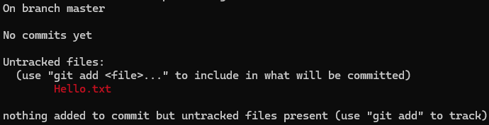
Adding a file
Within your folder, create and save a new text document using a text editor such as Microsoft Word or Notepad with some information e.g. “Hello World”
Return back to Bash/Terminal and type ‘git status’
This should tell us that there are untracked files - the text file we just added.

Slide 23
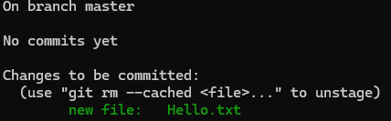
Staging a file
Now, we can use the command ‘git add (text file)’ to stage the file, which means that the file is ready to be committed.
If we had multiple files to stage, we can use the command ‘git add --all’ or ‘git add -A’
To check this has been done correctly, we can use the ‘git status’ command again

Slide 24
Committing a file
When we commit files, it is important to always include a clear message to help identify to yourself and others what has changed and when.
This is done using the command: ‘git commit -m “Useful message here”’

Slide 25
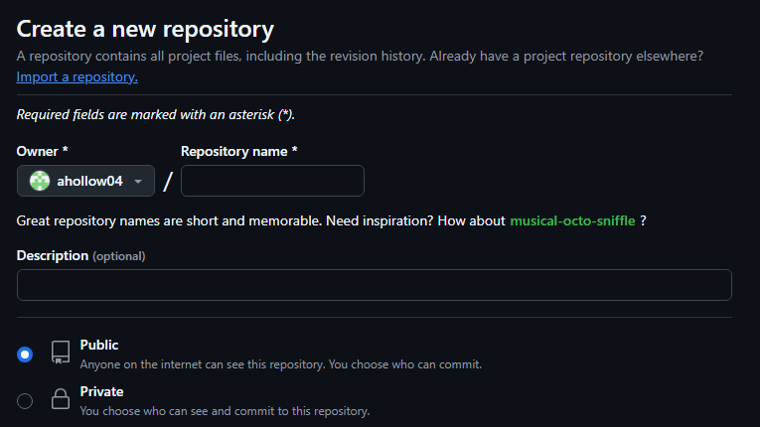
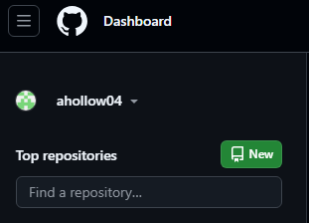
Pushing to GitHub
To be able to push to GitHub we first need to create a GitHub repository:

Slide 26
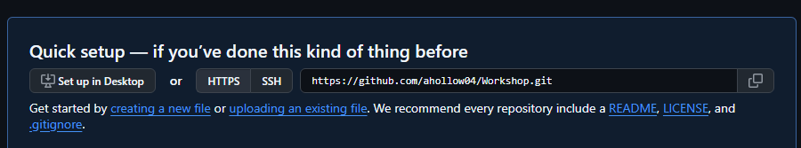
Pushing to GitHub
You will need to copy the URL and use it in the following command: ‘git remote add origin (paste URL)’

Slide 27
Pushing to GitHub
Now that you have set up a connection between your local Git repository and your online GitHub repository, you can now run the following command: ‘git push --set-upstream origin master’
(sometimes main instead of master)
Since this is the first time you are pushing to GitHub, you need to use ‘--set-upstream’ to identify the default branch you want to push to
If you refresh your GitHub page, you should see that your repository has updated

Slide 28
Pulling from GitHub
This is used to update your local version of a repository by using the command ‘git pull origin’
By using pull, we are using both fetch and merge commands behind the scenes, where fetch gets all of the change history and merge combines the current branch with a specified branch.

Slide 29
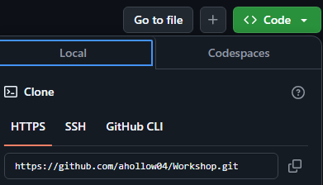
What if you want to work on an existing repository?
This can be done by cloning an existing repository so that you can work on it locally, using the command: ‘git clone (URL)’ where you can copy the URL from:
Updates can be committed using:
git add (file name)
git commit -m “”
git push

Slide 30
Branches
These are extremely useful to work on new features of a project in a contained area of the repository, ensuring that any breakages to code only affect the project branch and not the project itself.
Another benefit of branches is that multiple developers can work on separate tasks at the same time without causing multiple project conflicts.

Slide 31
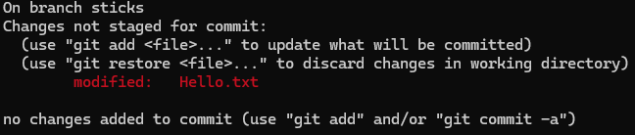
Pushing a branch to GitHub
In order to create a new branch, we use the following command: ‘git checkout -b (new branch name)’
Afterwards, make a couple of changes to the text file e.g. adding another word (don’t forget to save!)
Now, check the status of the current branch using ‘git status’ - it is important to note that this will tell you that you are on your new branch

Slide 32

Pushing a branch to GitHub
Like before, we can now use ‘git add (file name)’ and ‘git commit -m “(useful message)”’
Now, to push the newly created branch, we use the command ‘git push origin (new branch name)’

Slide 33
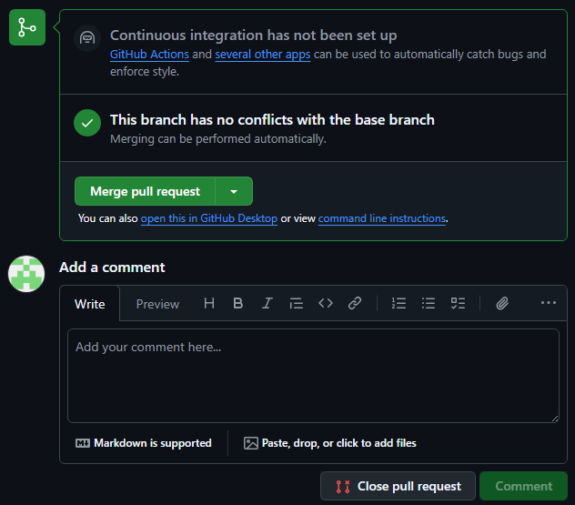
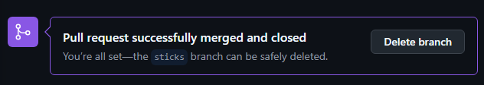

Pushing a branch to GitHub

Slide 34




Pulling a branch from GitHub
When a branch has been added to a GitHub repository, it will show up when you run ‘git pull’ e.g.
We can find out what branches are available locally and remotely by using ‘git branch -a’
And in order access remote branches locally we use ‘git checkout (branch name)’

Slide 35
Python

Slide 36
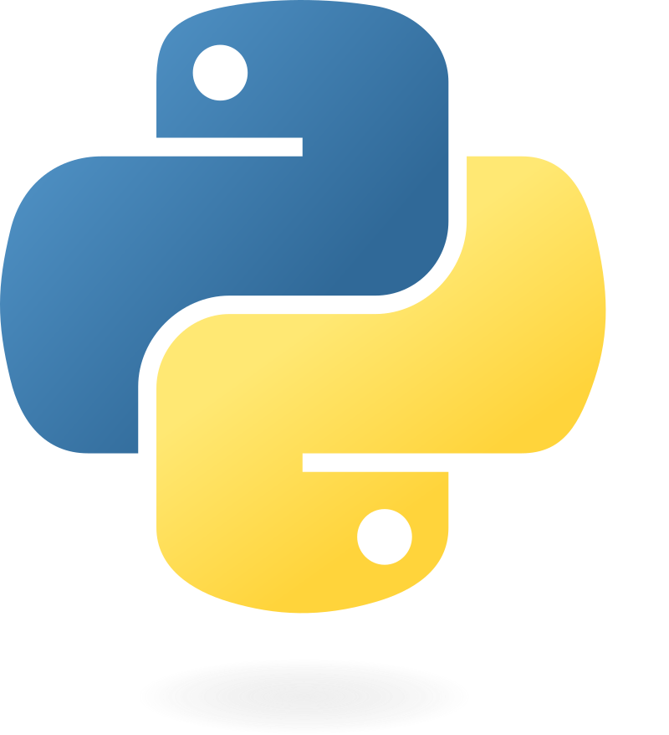
Python
A language used by almost everyone
Very beginner friendly
Also very powerful
Projects
AI / ML
Websites
Data Science
Simple GUI apps

Slide 37
Python venv
PIP sometimes breaks
System package issues
Version issues
To fix this, we use virtual environments!
https://docs.python.org/3/library/venv.html
Keeps Python packages separate
Less likely to break something else

Slide 38

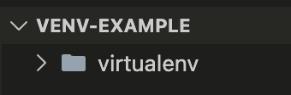

Slide 39






Slide 40
Unactivated:
Activated:

Slide 41
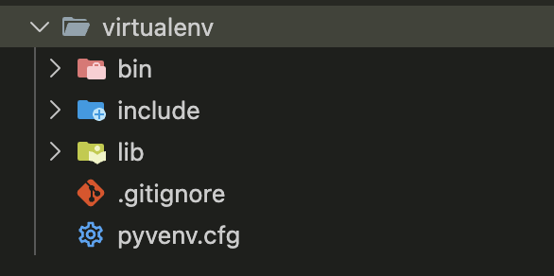

Slide 42
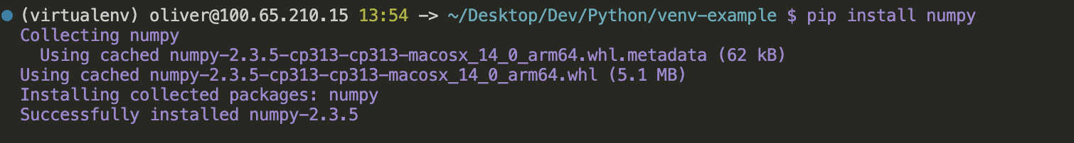

Slide 43
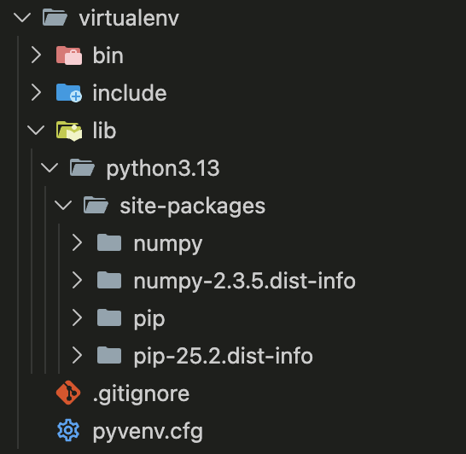

Slide 44


Requirements.txt
Will definitely be using Python libraries
More you use the harder it gets to keep track
Where requirements.txt comes in
Text file containing all the libraries (and versions if needed)

Slide 45
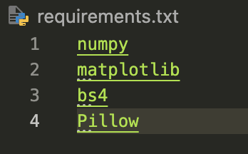
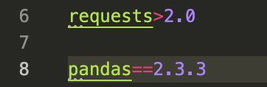

Slide 46
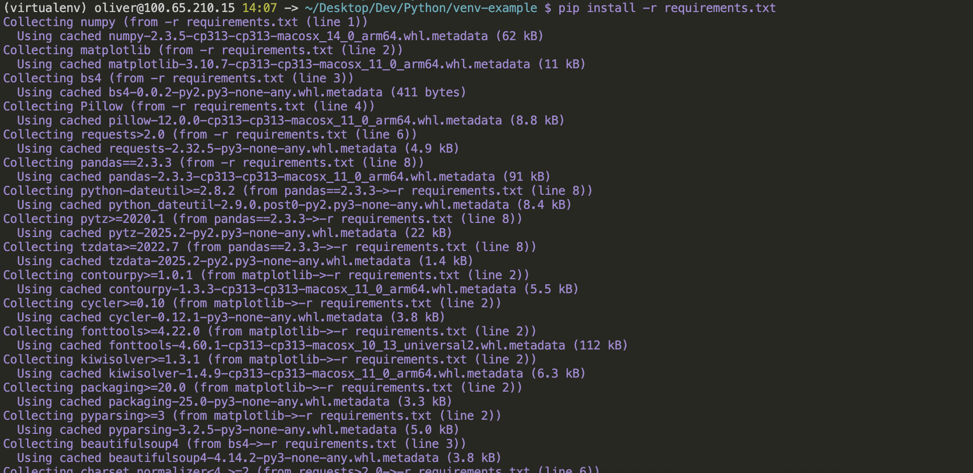

Slide 47
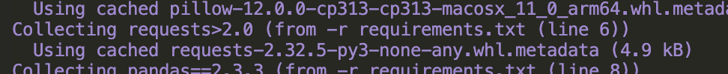
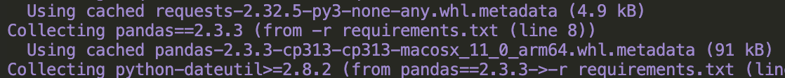

Slide 48
Libraries
Python is full of useful libraries:
MatPlotLib - graphs
Numpy - maths
Pandas - big data
scikit-learn - machine learning
Pytorch - machine learning
Kivy - GUI
Pick and choose what works for your project. Use libraries often, it saves you time!

Slide 49
Supabase

Slide 50
What is it?
Backend as a Service
Tools to handle common backend tasks without having to build them from scratch
Helps save development time
Don’t have to reinvent the wheel

Slide 51
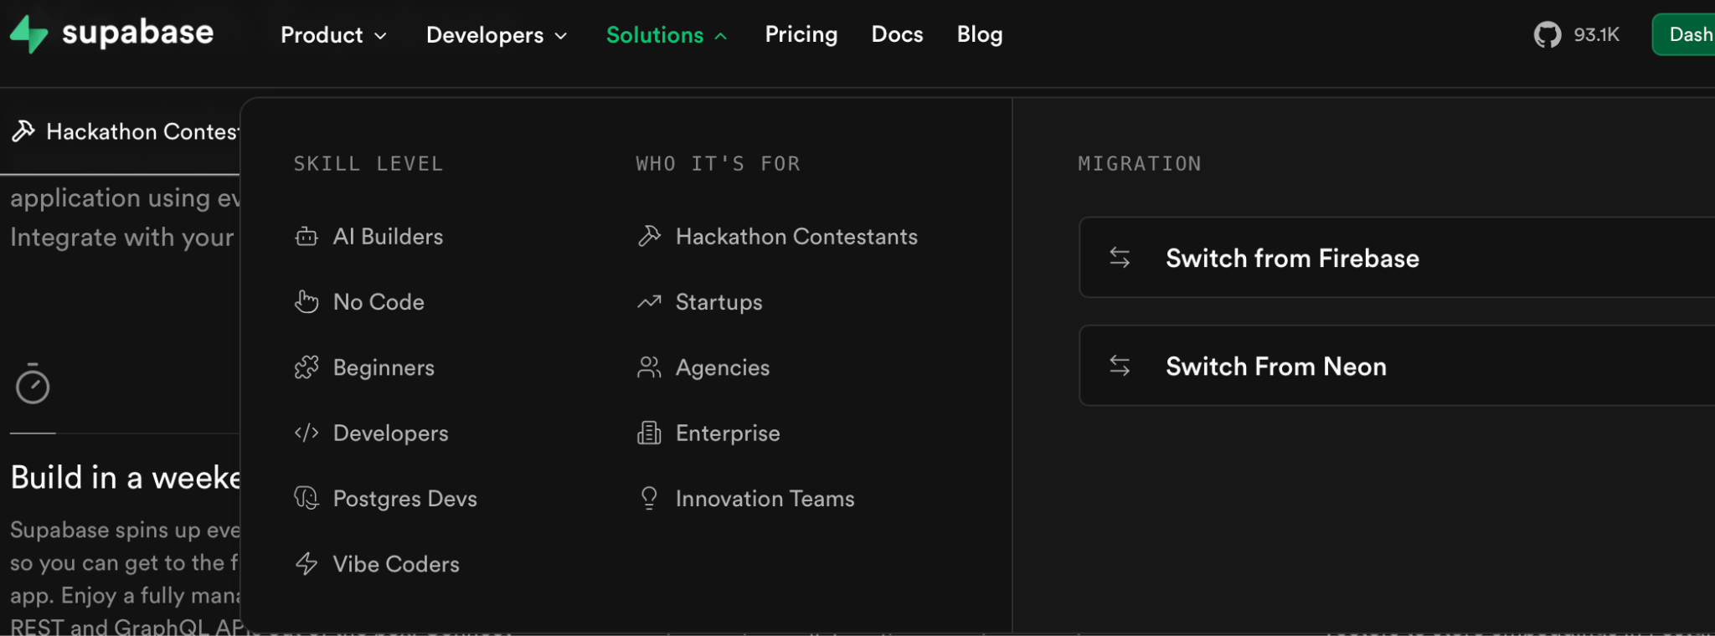
For Hackathon Contestants!

Slide 52
Features
Full database
Powered by PostGres
  Industry database
  Solid + Secure
Authentication
Email + Password
Magic link
  (Click a link in an email)
Realtime
Websockets
  Database changes (i.e realtime stock updates)
  Channels (i.e realtime chat)

Slide 53
Features (Cont.)
Storage
Upload images/files/anything
  Stored in ‘buckets’
  Allows for image modification (i.e for preview images)
Extras
Vectors (Machine learning embeddings, similarity searches)
Cron jobs (Run certain functions at certain intervals / times)
Queues (i.e Ensuring messages arrive in the order sent)

Slide 54
How to use
Host locally (via docker)
Free + no limits
Harder to use in a team
Free tier
Some limits (very generous)
Whole team can use (hosted remotely)
Email sending included

Slide 55
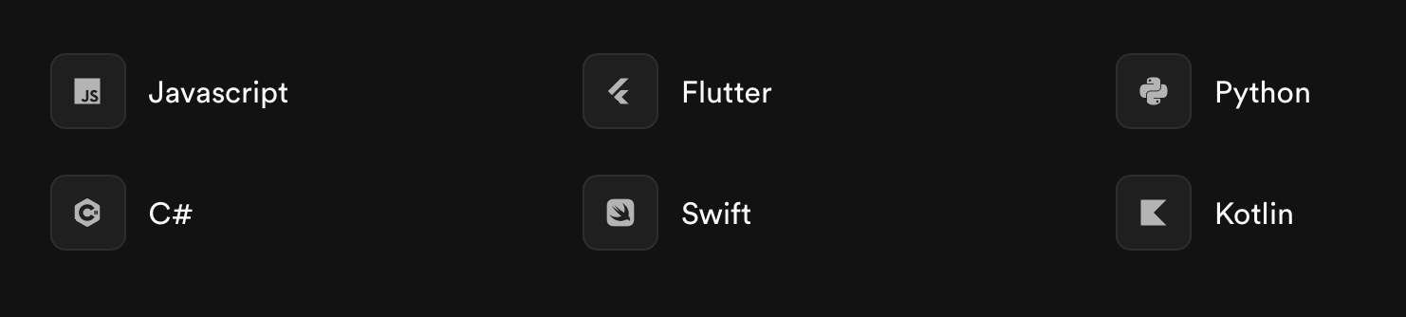
Loads of languages

Slide 56
React

Slide 57





React
What is React?
It is your front-end
A JavaScript library for building user interfaces using declarative, component-based views.
Open-source, widely used = lots of help online, easy to work with
Apps built using react:

Slide 58
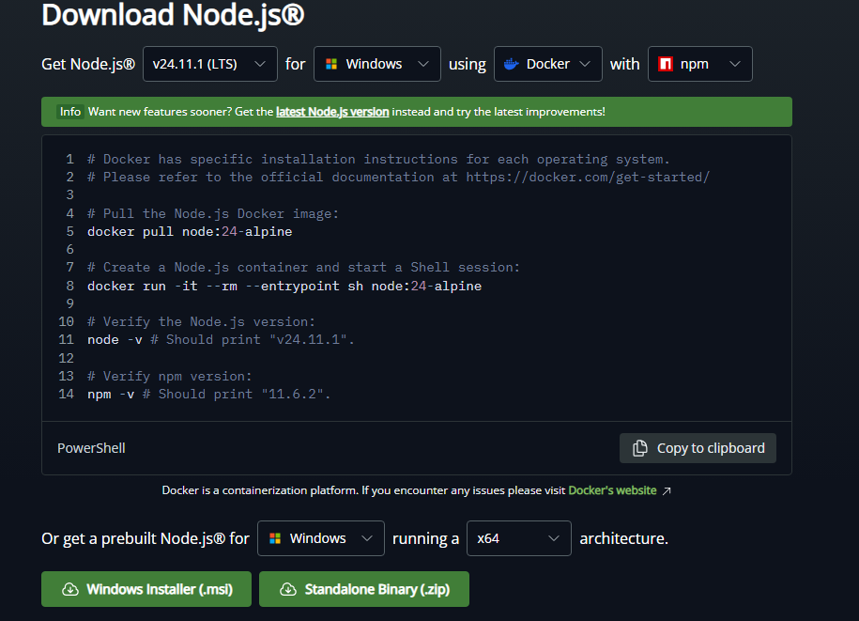
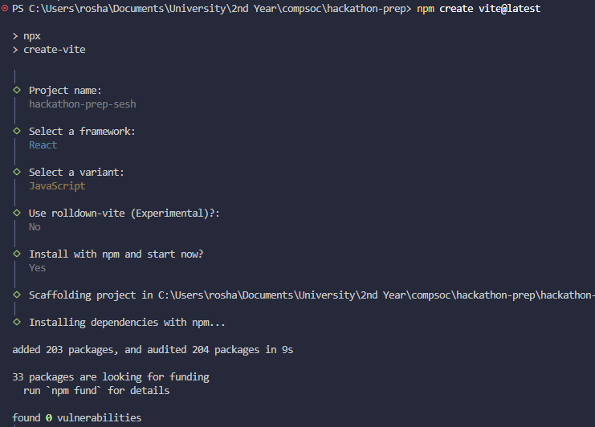
How to set it up
Install node.js
npm create vite@latest
  Enter project-name
  Framework: React
  Js vs Ts
  Rolldown-vite
  Install with npm
  Choose default options
npm install react-router-dom
👆

Slide 59
React Component Libraries
Bootstrap https://react-bootstrap.netlify.app/docs/getting-started/introduction
Material UI (MUI)
https://mui.com/material-ui/all-components/
Untitled UI
https://www.untitledui.com/react/components

Slide 60
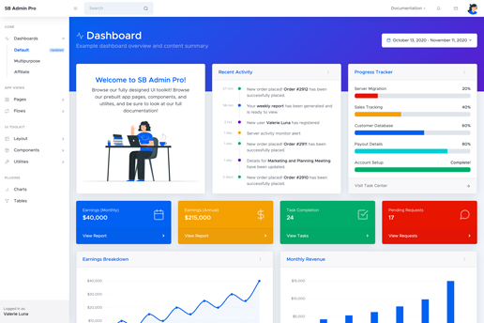
Bootstrap
npm install react-bootstrap bootstrapz - website

Slide 61
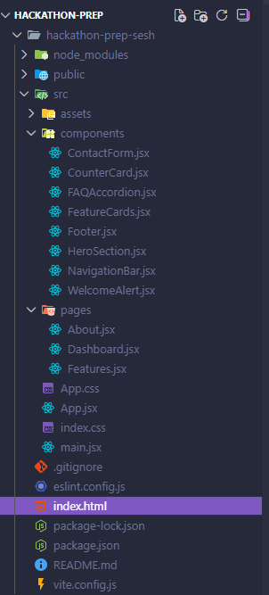
React - File Structure
index.html
  Main.jsx ← main entry point of application
    App.jsx ← holds different routes
      <page_name>.jsx (eg. Dashboard.jsx)
        components/
          ContactForm.jsx
          CounterCard.jsx
          …
          WelcomeAlert.jsx
❌
❌
❌
❌
❌
❌
❌
❌
Notes:
Files with “X” are ones you can forget for now. Your actual app, will be the other .jsx files. You need to set your app name in Index.html, add tailwind to app.css if you are going to use it.

Slide 62
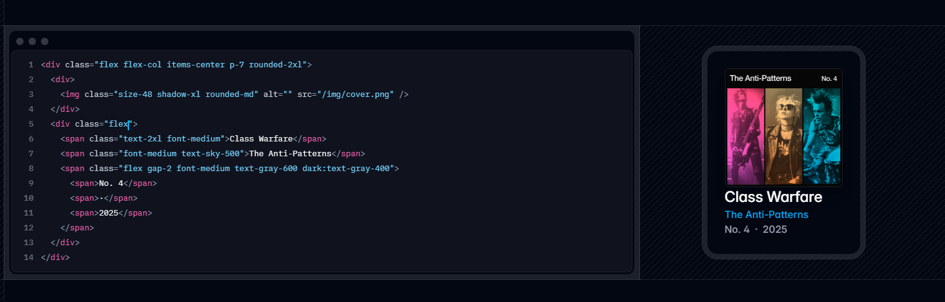
Tailwind
What is Tailwind?
Easy way to style
Utility-first CSS framework for building custom designs quickly without writing custom CSS
Notes:
Idea is: you can do everything in one file instead of swapping between html and css

Slide 63
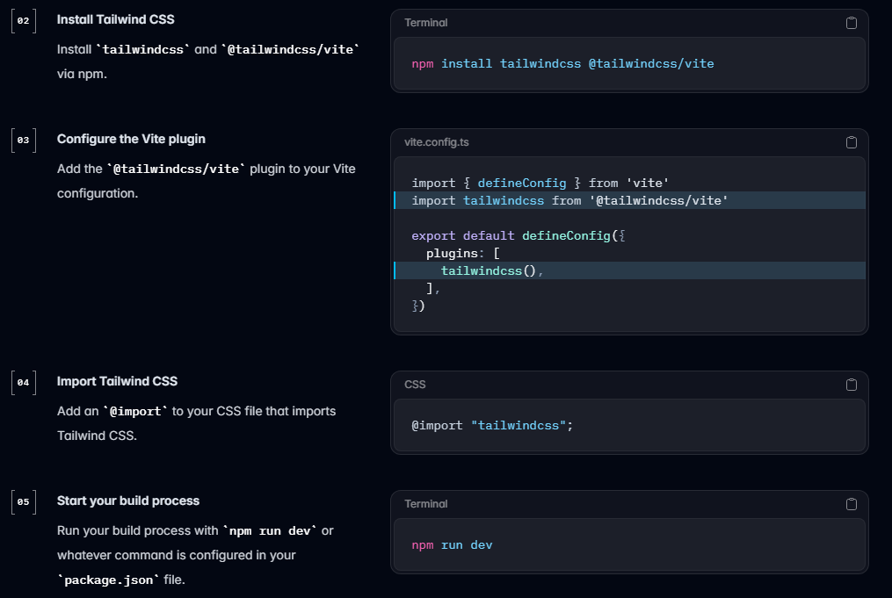
How to set it up
npm install tailwindcss @tailwindcss/vite
Add code to vite.config
Add @import “tailwindcss/vite”
to app.css
👆
Notes:
I wouldn’t bother covering this tbf, the setup is quite long I think its better if we talk about the benefits / how to use / etc

Slide 64
How to use it
React: className = “<css-code>”
Download “Tailwind CSS IntelliSense” on VSCode
Eg:
  text-<color>-strength(100,200…900) ← Text color
  bg-<color>-strength(100,200…900) ← background color
  Text-4x1 ← Text Size
  https://tailwindcss.com/docs/styling-with-utility-classes
Notes:
I wouldn’t bother covering this tbf, the setup is quite long I think its better if we talk about the benefits / how to use / etc

Slide 65
Flask

Slide 66
Flask
What is Flask?
A web framework for Python
Simple and lightweight
Allows you a lot of control over exactly how it will function
Packaged with a webserver so can be ran on your device
(Only for use in testing)
Notes:
Flask is a lightweight web framework for Python
It allows you to easily setup a basic web application, and can be used for websites like a personal blog, recipe site, or anything you can really think of
Flask is quick and simple, as it allows you make whatever functionality you want, without being weighed down by strict requirements

Slide 67
Flask
The basics
Setup
Define routes
Return HTML
GET / POST requests
HTML templates with custom data
If time allows: Blueprints

Slide 68
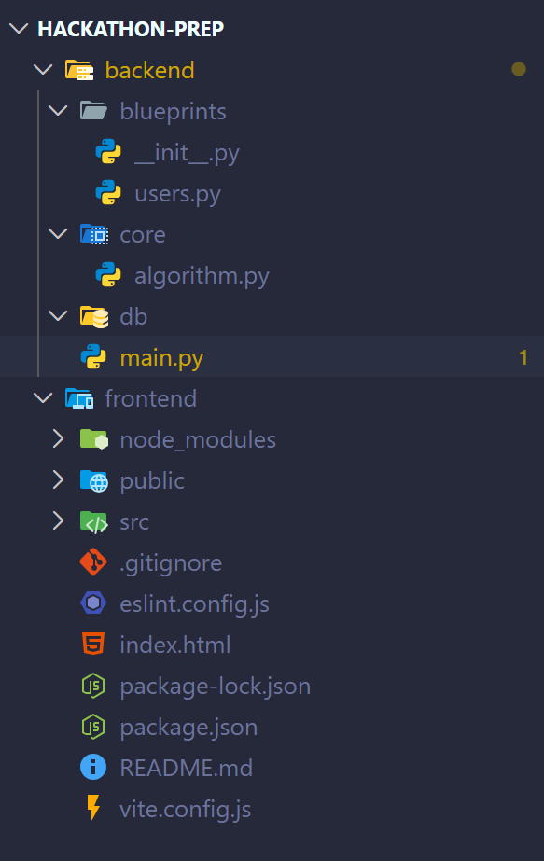
Flask - Setup
pip install flask
pip install flask-cors
Add flask to requirements.txt
Notes:
This is all you need to get started with flask, however it would be kind of useless if we didn’t define any actions for the server to use :/

Slide 69
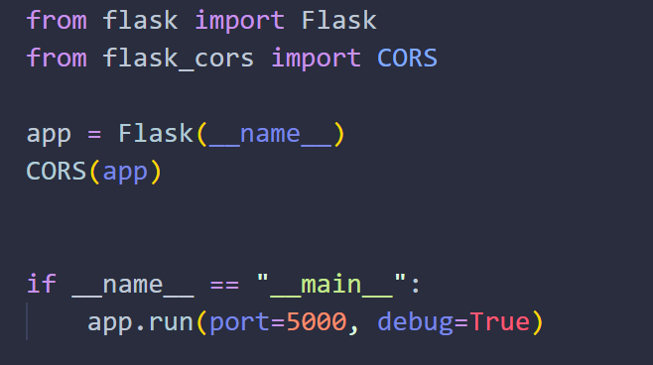
Flask - Setup
Basics of a flask webapp:
Notes:
This is all you need to get started with flask, however it would be kind of useless if we didn’t define any actions for the server to use :/

Slide 70

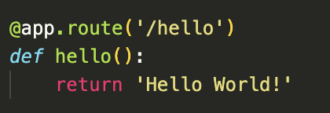

Flask - Routes
Routes
Basic part of any webapp
Communication between front and backend

Slide 71
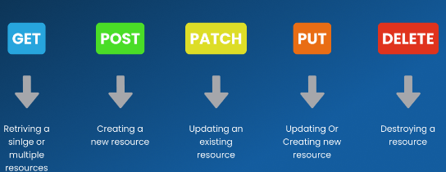
Types of HTTP Requeqsts
Example:
@app.route(‘/hello’, methods = [“GET”])
def Hello(): … return

Slide 72
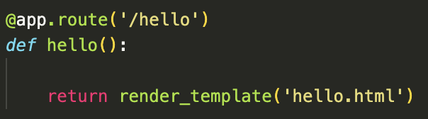
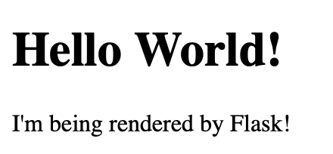

Flask - HTML
You can also return html pages so that your website looks nicer!
Requires that ‘render_template’ be imported from Flask
All HTML files must be placed
within a folder title ‘Templates’

Slide 73
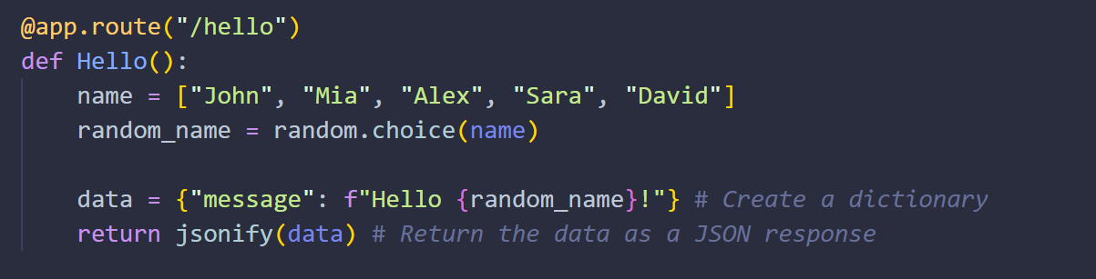
Flask
How do we send data from the server to the pages?

Slide 74
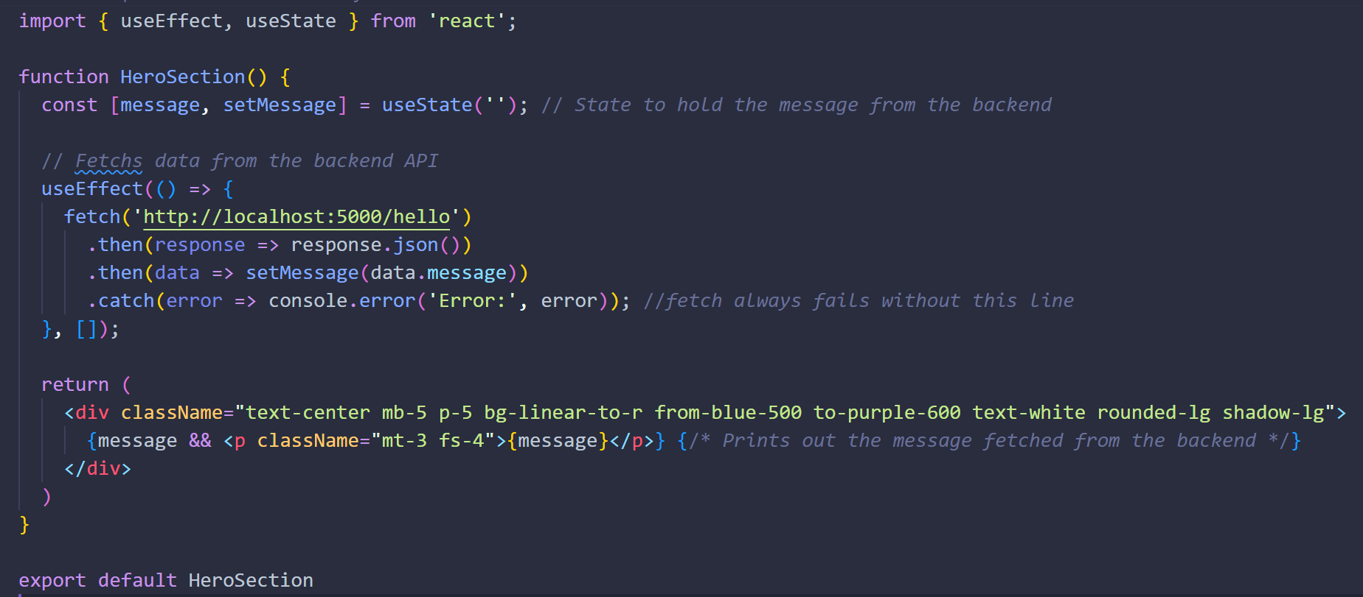
Flask - react side
This is how it fetches the message from backend
Notes:
import subprocess
import sys
import os
if sys.platform == "win32":
python = ".venv\\Scripts\\python.exe"
else:
python = ".venv/bin/python"
subprocess.Popen([python, "backend/main.py"])
os.chdir("frontend")
subprocess.run(["npm", "run", "dev"])

Slide 75



Flask - Outcome
Notes:
Every Time page is reloaded the route is called and name changes

Slide 76
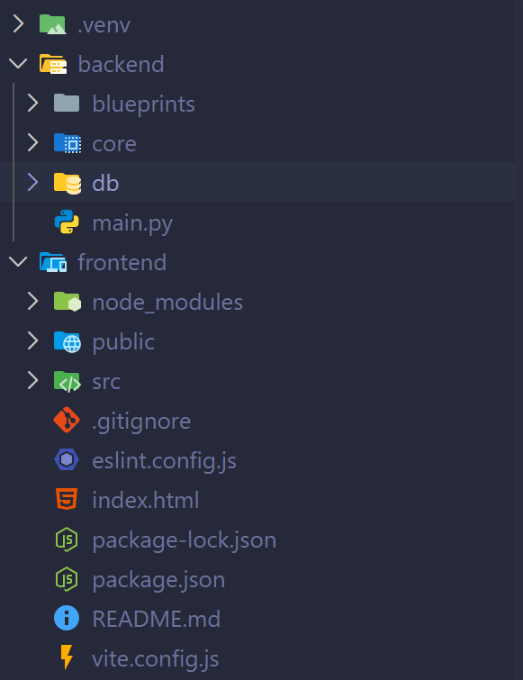
Running Current Setup
To run the app:
Start venv
Run main.py first
Chdir to frontend
Run npm run dev

Slide 77
QoL Change
Create app.py in root folder:
import subprocess
import sys
import os
if sys.platform == "win32":
python = ".venv\\Scripts\\python.exe"
npm = "npm.cmd"
else:
python = ".venv/bin/python"
npm = "npm"
subprocess.Popen([python, "backend/main.py"]) # Writes python backend/main.py in terminal
os.chdir("frontend") # Changes directory to frontend
subprocess.run([npm, "run", "dev"]) # Writes npm run dev in terminal
Notes:
If you are using this code, make sure you have the project structure:
> backend
> main.py
> frontend
>...react files…
—----------------------------------
If you dont, then change the respective names accordingly

Slide 78
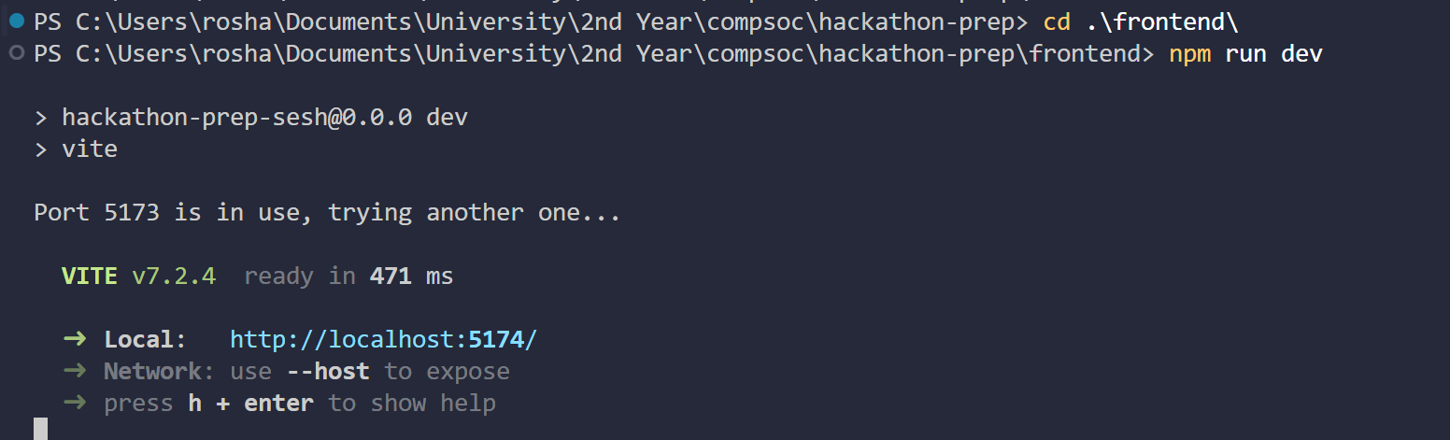
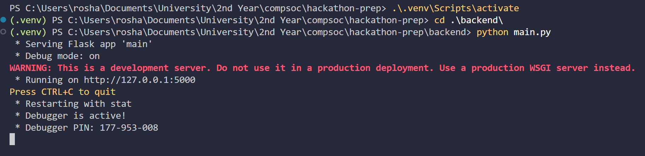
QoL Change
Single terminal
vs
> python start.py

Slide 79

Flask - Blueprints
We can create blueprints to separate routes into better defined categories and keep our files much more organised

Slide 80
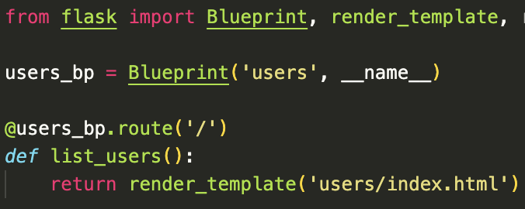
Flask - Blueprints

Slide 81
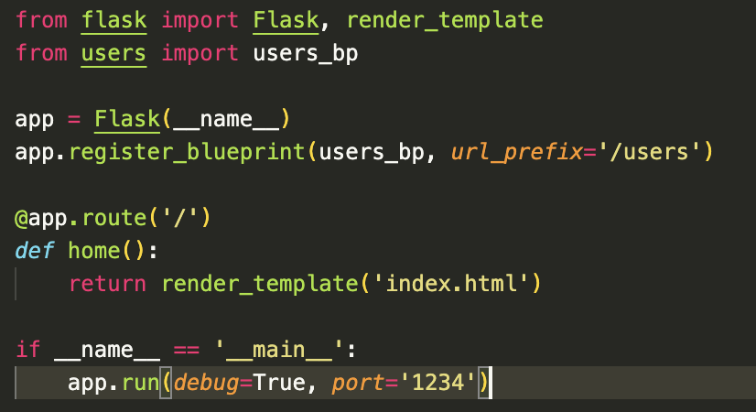
Flask - Blueprints

Slide 82


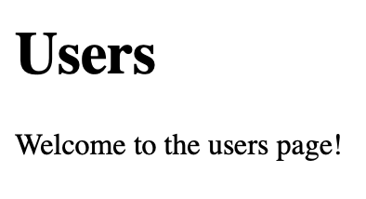
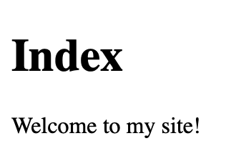
Flask - Blueprints

Slide 83
Flask - Wrapup
Those are the basics of Flask
Flask has other cool features built in that you can read more about on their website: https://flask.palletsprojects.com/
Such as:
Blueprints
Error Pages
Signals

Slide 84
Additional Prep Work
Learn how to make forms and process them before the hackathon!!
No matter what techstack you use, this will be always be a key element

Slide 85
Devpost

Slide 86
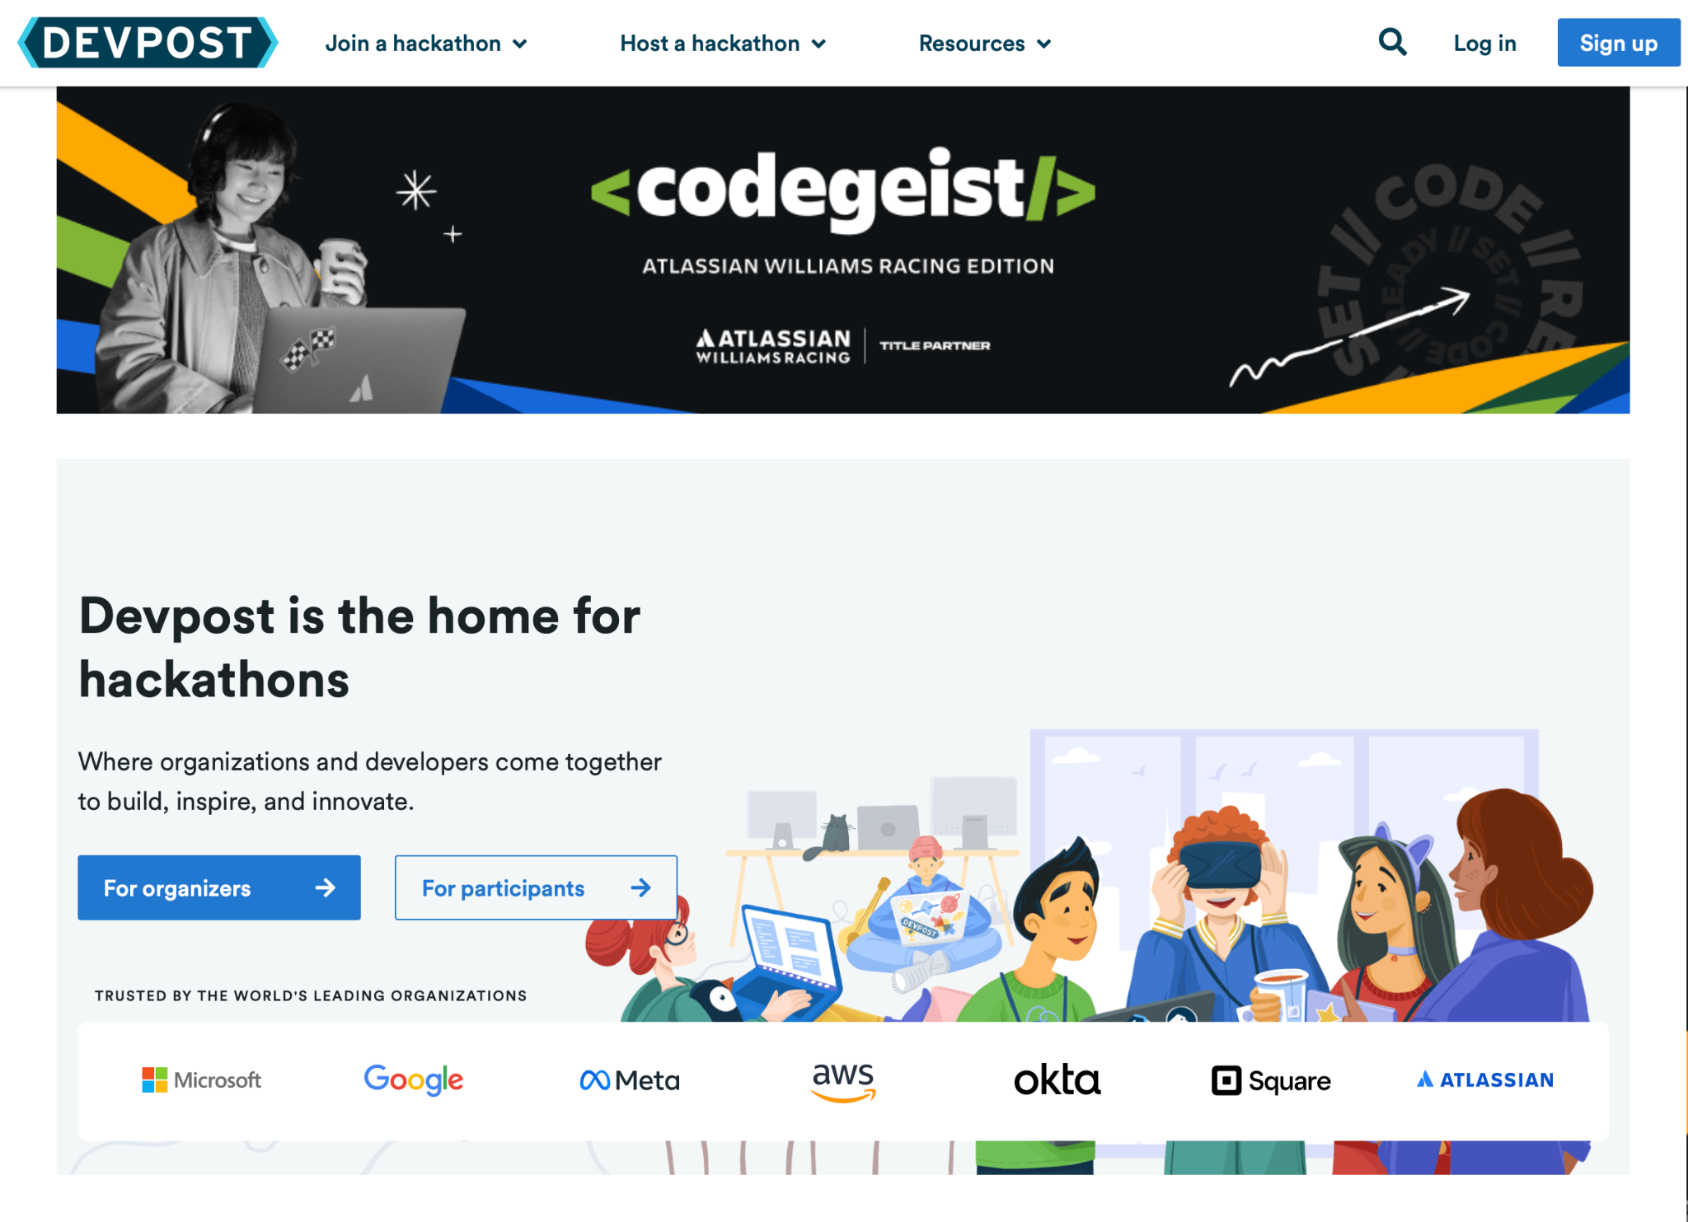

Slide 87
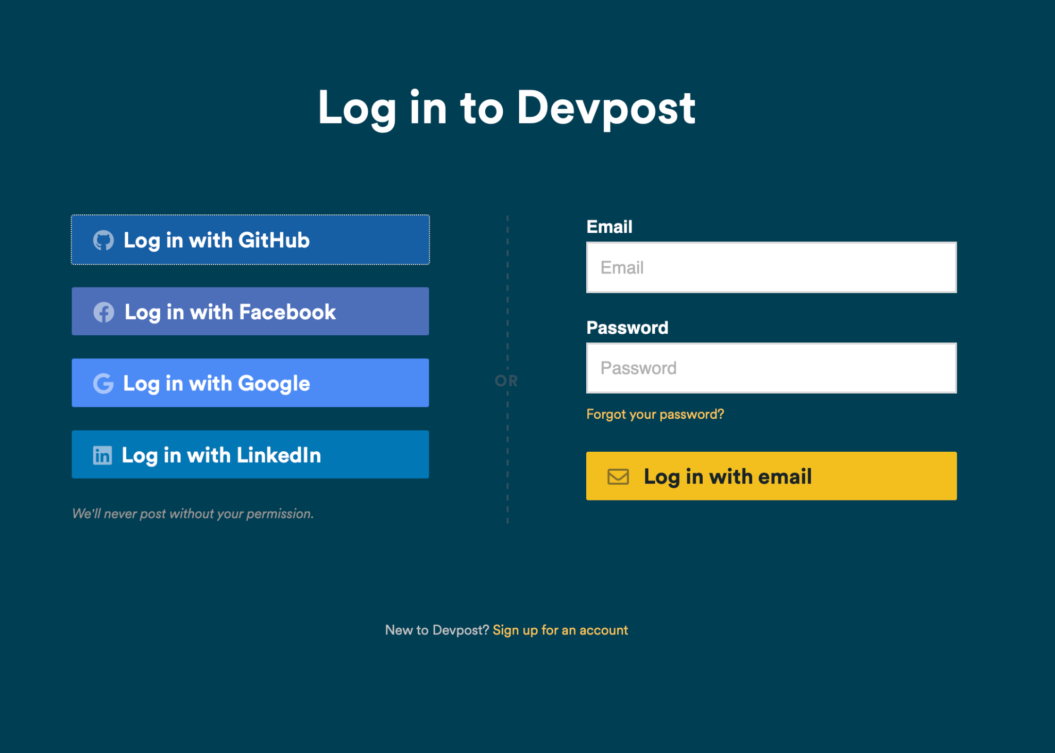

Slide 88
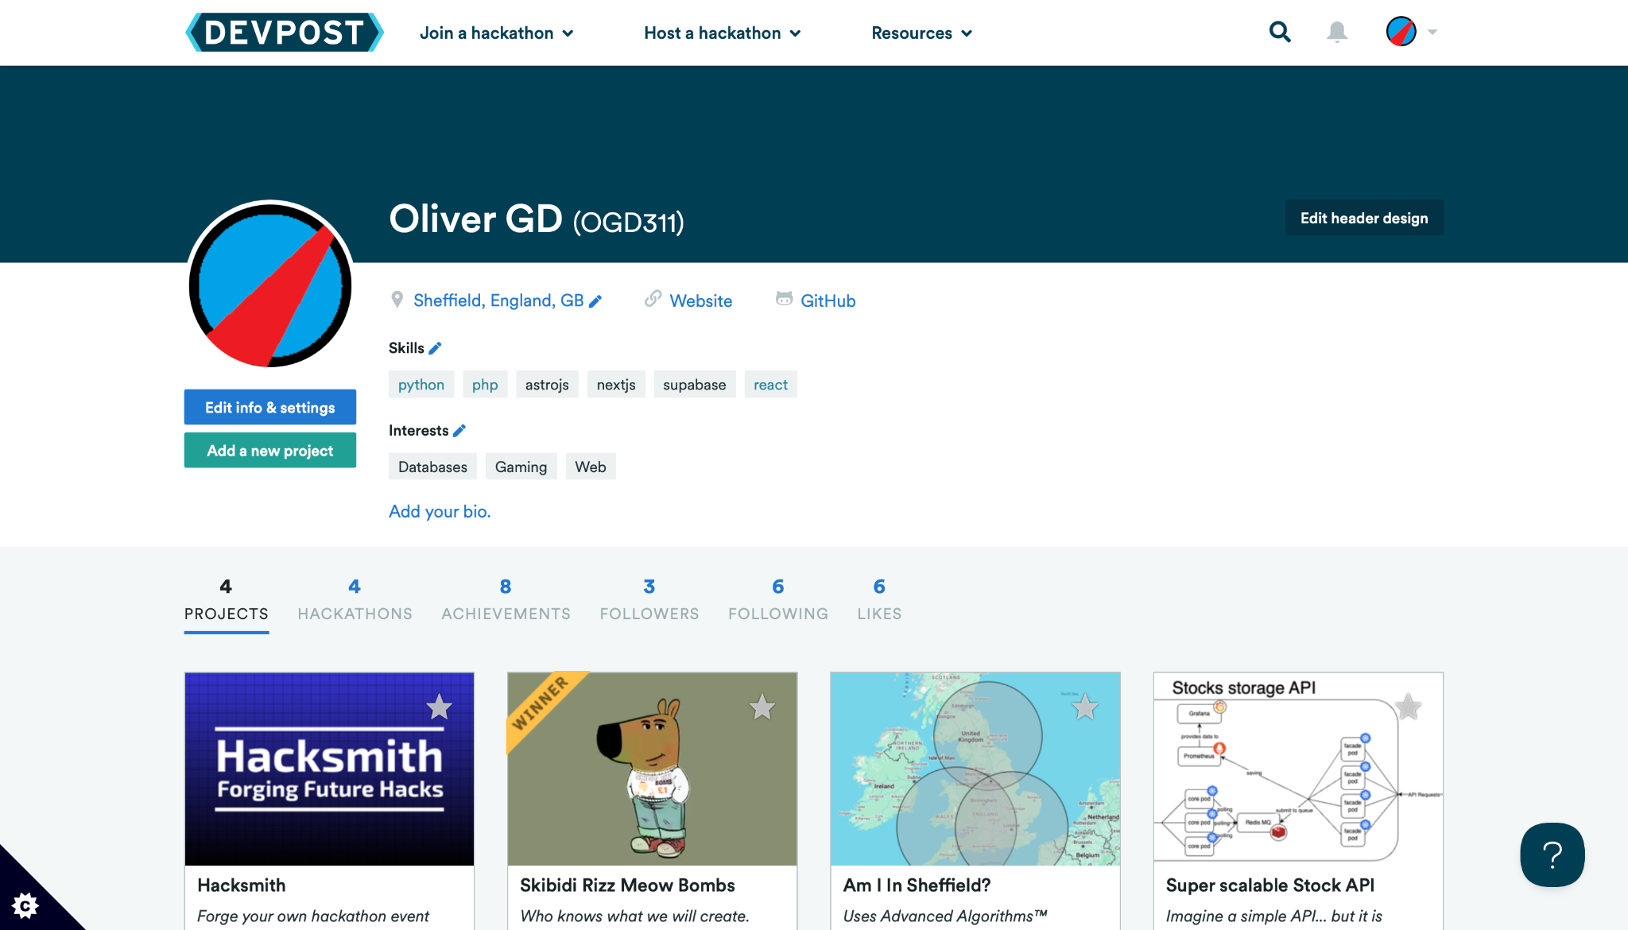

Slide 89
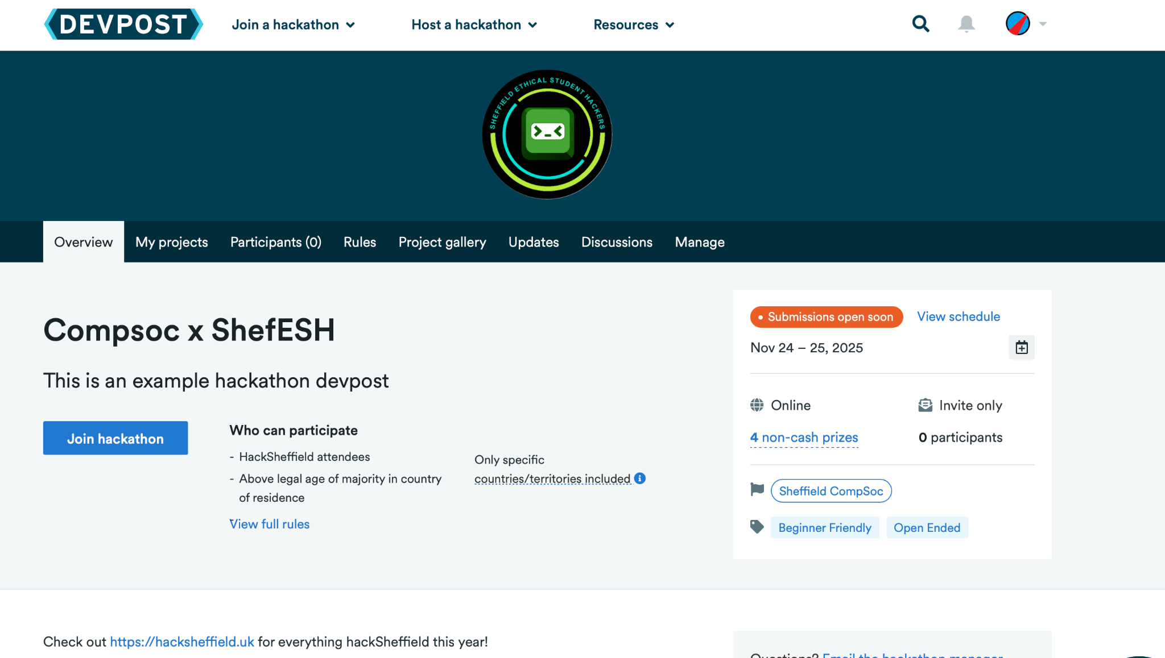
https://compsoc-x-shefesh.devpost.com

Slide 90


Slide 91


Slide 92


Slide 93


Slide 94


Slide 95


Slide 96


Slide 97


Slide 98


Slide 99


Slide 100



Slide 101


Slide 102


Slide 103

Project Gallery

Slide 104
Do’s and Don’ts

Slide 105
Do’s
Try out sponsor activities
Engage with partner society activities
Make a plan (even a basic one)
Leverage existing tools and libraries
Keep your project demo-friendly and work on a pitch
Take care of yourself

Slide 106
Don’ts
Spend ages worrying about design
Spend ages making everything perfect
Overcomplicate your idea
Forget the submission
Neglect your pitch
Skip testing
Ignore networking

Slide 107
What to Bring
Essentials
Laptop
Chargers
  Phone, Laptop, etc
Student ID
Ticket
Medication

Slide 108
Comfort
Something warm
  Hoodies / Blankets etc
Water bottle
  Important to stay hydrated
Snacks
  Bring some snacks
  NO NUTS
Toiletries
  Toothbrush + toothpaste
  Deodorant

Slide 109
Thank you for attending!
We look forward to seeing you at the Hackathon!
And GOOD LUCKKK 👍👍

